Slide 1
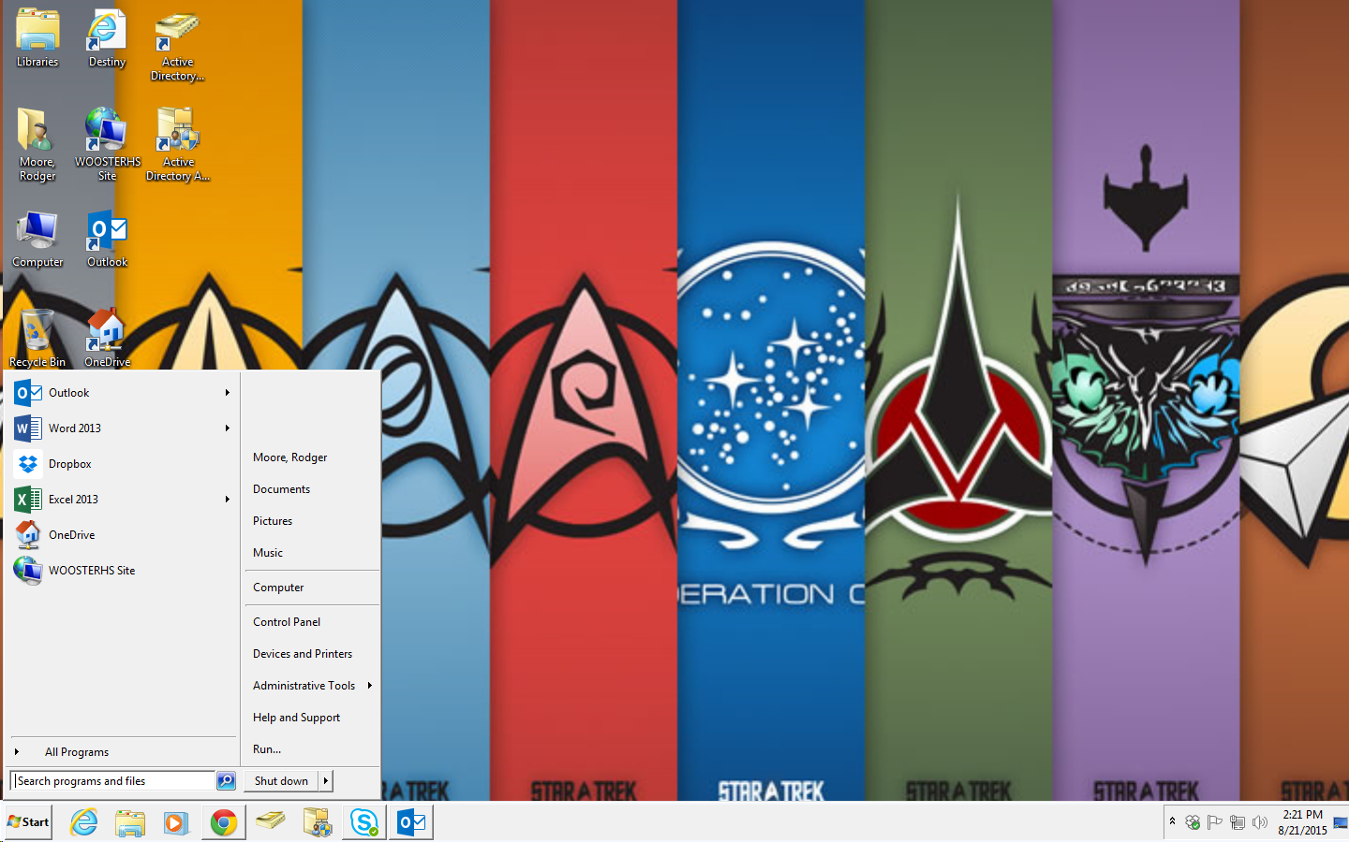
Installing programs from your application menu
Click start

Slide 2
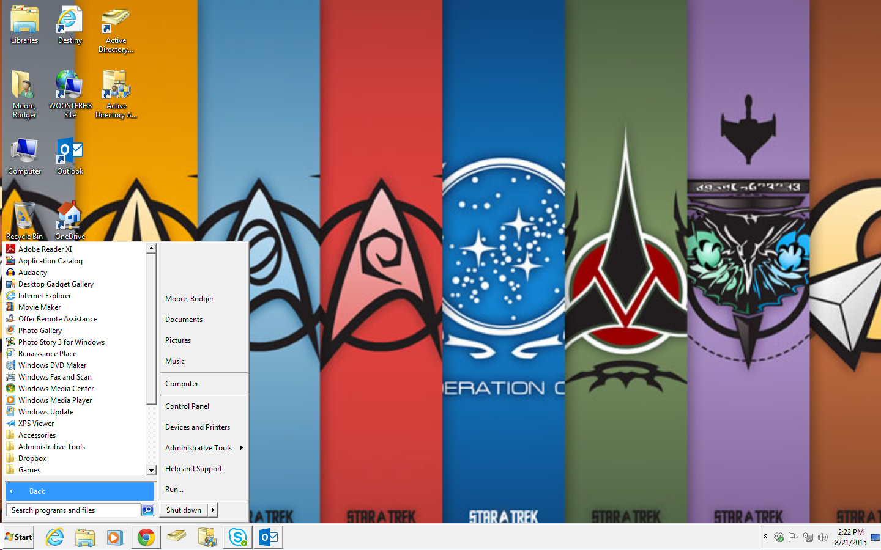
Programs

Slide 3
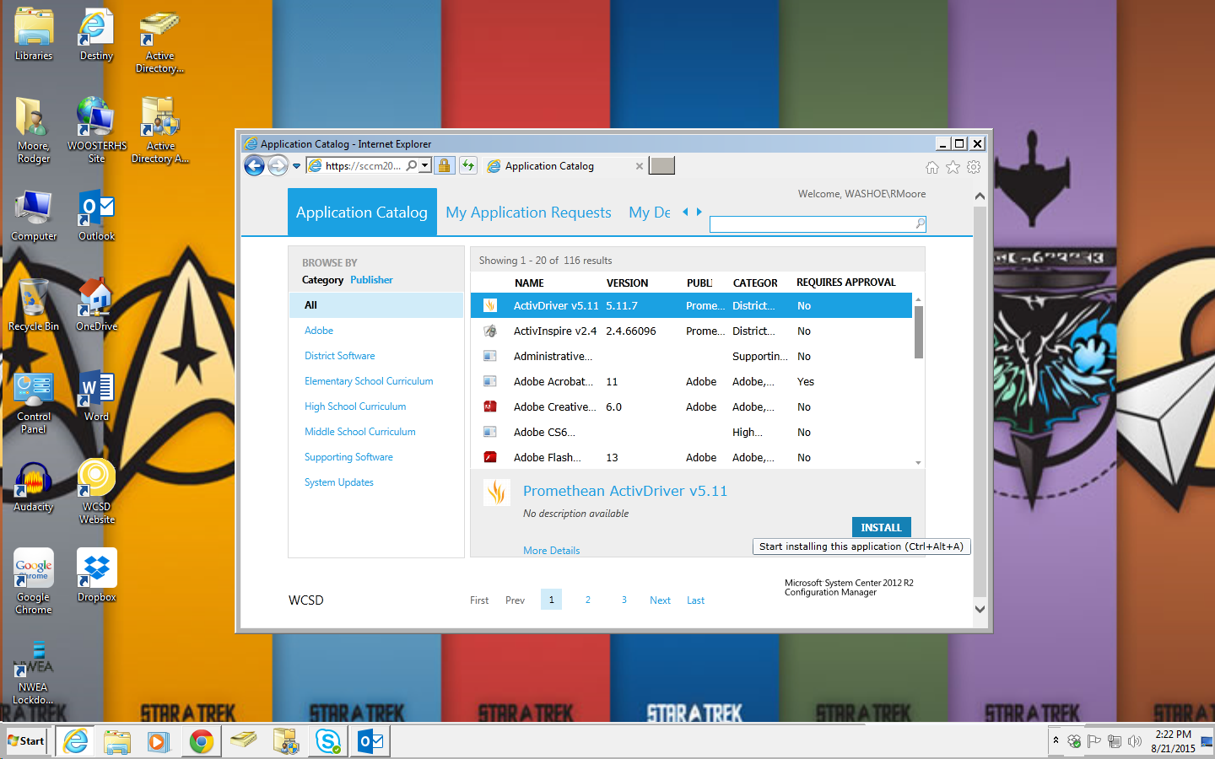
Find the program you need and start the install.

